Slide 1
Object Orientation
PLC
J. Heliotis

Slide 2
Exercise
In assigned groups
  Write a class for a playing card.
    suit('C,'D,'H,'S) and rank(integer)
  Write comparison procs less, equal
    First, compare suits; use order above.
    If cards have same suit, base less on rank.
  Write an asString proc that returns a string (list of characters) of the card in the format
    <suit><rank>
    example: "H12"
Due Tuesday by end-of-day.

Slide 3
Other Information
Checking out Fossum's New OBJ Env slides:
  Slides 18-26
  More precise and detailed description of the class and object structures than is shown here

Slide 4
1. Issues and Concepts
PLC
J. Heliotis

Slide 5
New Issues in OO Languages
Types and classes
Creation/destruction
Self
Scope
Feature access
Inheritance
  Polymorphism

Slide 6
Is a class a type?
'Type' can be
  a set of values (denotational)
  a set of legal operations (abstraction)
  a representation (constructive)
'Class' adds
  a set of operation
  implementations

Slide 7
Prototype-based Languages
Prototype-based
  Self
  [JavaScript]
Objects contain everything they need,
  including a pointer to another object to which all operations not implemented locally are delegated.

Slide 8
Other Interpreted Languages
Classes ⊆ Objects
  Smalltalk
  Python
  [Java]
Objects point to their classes.
  Classes may have metaclasses.
Classes also point to their superclasses.

Slide 9
Fully Compiled Languages
Classes don't exist at run time
  C++
    (Well, there is RTTI.)
Objects are structs, with
  Associated functions that contain an extra parameter with a struct pointer
    Possibly hidden in source code
  Indirect function address lookup tables for polymorphism

Slide 10
Types and Classes
Object descriptions are classes.
Classes are an extension of the record concept...

Slide 11
Pre-OO and OO
What does this tell us?
// ADT Manager struct Foo { T1 a; T2 b; }; void init( struct Foo *f ) { // … } void m( struct Foo *f ) { // … } | // True class class Foo { T1 a; T2 b; Foo() { // … } void m() { // … } };

Slide 12
Module: Precursor to Class
module Foo {
struct Data {
T1 a;
T2 b;
};
Data *create() {
// …
}
void m(Data *d) {
// …
}
}
import Foo;
Foo.Data *x = Foo.create();
Foo.m(x);
print( x.a, x.b );
close to Python, except...?
Modula, Mesa, Ada, CLU (see later slide)
Notes:
In python, there is no module in syntax or scope. The file name is used as the module name.

Slide 13
Classes As Extensions of ADT Managers
# File tree.py
class BSTNode(object):
__slots__ = ("value","left","right")
def makeNode(v):
n = BSTNode()
n.value = v
n.left = None
n.right = None
return n
continued…

Slide 14
Classes As Extensions of ADT Managers
def add( n, newValue ):
if newValue < n.value:
if n.left is not None:
add( n.left, newValue )
else:
n.left = makeNode( newValue )
else:
if n.right is not None:
add( n.right, newValue )
else:
n.right = makeNode( newValue )

Slide 15
CLU [MIT, Barbara Liskov et al]
complex_number = cluster is
add, subtract, multiply, ...
rep = record [
real_part: real,
imag_part: real ]
add = proc ... end add;
subtract = proc ... end subtract;
multiply = proc ... end multiply;
...
end complex_number;
Notes:
Had pretty much everything OO except for inheritance. I did not find how to do construction.

Slide 16
Creation/Destruction
Old
  obj = malloc( sizeof( struct Foo ) );
  Foo_init( obj );
OO
  obj = new Foo();
What's happening here?
Allocates memory
Initializes
data
Notes:
The constructor is actually a method. It runs only after the object exists.

Slide 17
Self: A Method Call's Target Object
An extra argument is added to each instance subroutine's parameter list.
It is known as
  self (Smalltalk, Python*, Ruby, Ada-95)
  this (Simula, C++, Java, C#)
  Current (Eiffel)
  self and this (PLCC's OBJ language!?!)
Notes:
Python really doesn't care what you call it.

Slide 18
Scope
Recall: What is the scope of x inside m?
  global?
  file?
  subroutine local?
Technically, x is not a variable.
It's a field inside the record named by this.
class C {
int x;
void m() {
x = 5;
}
}
class C {
int x;
void m(C this) {
this.x = 5;
}
}
Notes:
Before clicking again, ask the class: when the class declaration is "executed", is m created? is x created?

Slide 19
Again: invoking an operation
C obj;
obj.m( x, y );
  ⇓
struct C obj;
m( obj, x, y );
Does an OO language do anything more than adjust syntax?
Notes:
Inheritance is far easier to express in an OO language.

Slide 20
Feature Access
3- or 4-level (C++, Java, C#)
  public
  protected (loophole!)
  private
  internal
by class (Eiffel)
  feature – public
  feature { SOME_CLASS }
  – restricted to SOME_CLASS & descendants
  feature { NONE }
  – accessible only to this class's routines (not via Current.)
friend

Slide 21
Side Trip
Nested Classes, in Java
class Base {
boolean c;
class Inner {
int a;
float b;
}
}
Base
Inner
c
this
a
6
b
0.0932
Base.this
Instance of nested class requires instance of outer class.

Slide 22
Inheritance
Structure of subclass is appended to structure of superclass.
Offsets to fields in new structure are easy to compute:
could be
instance of
Base or
Derived
a
6
b
0.0932
class Base {
int a;
float b;
}
class Derived: Base {
Base *parent;
}
parent
a: @objectPointer
b: @objectPointer+4
parent: @objectPointer+8

Slide 23
Polymorphism
Two approaches:
  Virtual function table
  Class objects

Slide 24
Function Table
class Base {
int a;
float b;
void f1(){…}
void f2(){…}
void f3(){…}
}
class Derived: Base {
void f1(){…}
void f2(){…}
}
@Derived.f1
@Base.f1
@Derived.f2
@Base.f2
@Base.f3
@Base.f3
for
Derived
for
Base
fn_tbl
a
6
b
0.0932
C++ compilers typically use
this for virtual functions.

Slide 25
Class Object
(closer to PLCC language)
class Base {
int a;
float b;
static int c;
void f1(){…}
void f2(){…}
void f3(){…}
}
class Derived: Base {
void f1(){…}
void f2(){…}
}
nil
@Base.f1
superclass pointer
@Base.f2
@Base.f3
c
@Derived.f1
@Derived.f2
class pointer
class
a
6
b
0.0932

Slide 26
Multiple Inheritance in Python
There is a tree representing the ancestors of a class.
A linearization of the classes in that tree is constructed.
When given a method name, each class in that linear list is checked for the presence of the method.
(attributes?)

Slide 27
Multiple Inheritance in Eiffel
If a new class inherits another class more than once, only one instance of the other class's attributes appears in an instance of the new class.
Identically named attributes (fields) are automatically merged together.
Identically named routines must be dealt with.
Possibilities:
  Rename a feature
  Select a feature as the polymorphic version of something inherited from multiple ancestors
  Undefine a version of a feature from an ancestor class (effectively selects the one left)

Slide 28
What Goes Where?
static variables
static methods
instance variables
instance methods
inheritance relationships
Classes should contain:
Objects should contain:
Class-based* variable
  declarations
  values
Instance variable declarations
Method definitions
  instance-based
  class-based*
  Constructors
Inheritance relationships
Instance variable values
*class-based=="static" in Java/C++

Slide 29
2. OBJ
The Object-Oriented Language using PLCC

Slide 30
But First: Other Stuff in OBJ
--> {display 19; display 84; newline}
1984
nil
--> {display# 19; display 84; newline}
19 84
nil
--> display# [1,2,3,[4,5]]
[1,2,3,[4,5]] [1,2,3,[4,5]]
--> display# "abc"
[97,98,99] [97,98,99]
--> { putc 97; newline }

Slide 31
The Basics
We build objects using environments.
A class's environment includes (as we learned)
  static variables
  superclass relationship
An object's environment includes (as we learned)
  instance variables
  (instance) methods
  other built-in stuff to navigate the hierarchies

Slide 32

Environment Qualification
Examples
--> define x = 1
x
--> define outer = @
outer
--> define inner = let x = 2 in @
inner
--> <outer>x
1
--> <inner>x
2

Slide 33
Fossum's First Example
define c1 =
class % extends an unnamed class
field x
field y end
define c2 =
class extends c1
field z
field x end
define obj1 = new c1
define obj2 = new c2
<obj1>set x = 3
<obj2>set x = 5
<obj1>x % evaluates to 3
Similar to
obj1.x = 3
…except that the environment applies to the entire expression.

Slide 34
Things to Note
define c1 =
class
field x
field y end
define c2 =
class extends c1
field z
field x end
define obj1 = new c1
define obj2 = new c2
<obj1>set x = 3
<obj2>set x = 5
<obj1>x % evaluates to 3
Classes are special environments.
Objects are special environments.
But classes are not objects.
Up until now we could not treat an environment as a first class entity.
  We can assign an environment to a variable.
  We can write an expression that evaluates to an environment.
  (Env's not "behind the curtain")
<env>exp
"Evaluate the expression exp in the context of the environment env."

Slide 35
Fossum's Example Again
Note use of objects as environments
define c1 =
class % extends an unnamed class
field x
field y end
define c2 =
class extends c1
field z
field x end
define obj1 = new c1
define obj2 = new c2
<obj1>set x = 3
<obj2>set x = 5
<obj1>x % evaluates to 3
Class expressions
can go in the angle
brackets, too.
What would that simulate?
Notes:
static stuff!

Slide 36
Using environments in methods
--> define Pair
class
field x
field y
method sum =
proc() +(x,y)
end
Pair
--> define p = new Pair
p
--> set <p>x = 2
2
--> <p>x
2
--> <p>set y = 13
13
--> <p>.sum()
15
--> .<p>sum()
15
ValRefs!
so does it matter which one we do?
oh yeah

Slide 37
and you thought it was hard to remember the dot…
--> define Num = class field x method plus = proc( a ) +( x, a ) end
--> define x = 10
x
--> define n = new Num
n
--> <n>set x = 2
2
--> <n>.plus( x )
4
--> .<n>plus( x )
12
Which one should we normally use?

Slide 38
Reminder:
OOP Design Approaches
@Derived.f1
@Base.f1
nil
@Derived.f2
@Base.f2
@Base.f1
@Base.f3
@Base.f3
superclass pointer
@Base.f2
for
Derived
for
Base
@Base.f3
c
@Derived.f1
fn_tbl
@Derived.f2
a
6
The
function
table
The
class
object
chain
b
0.0932
class pointer
class
a
6
b
0.0932

Slide 39
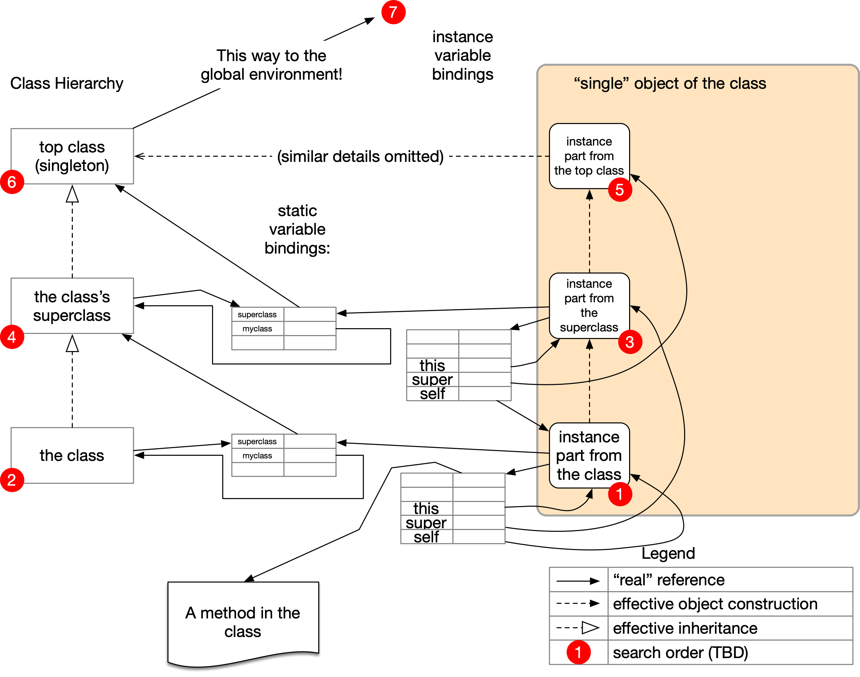
… and then there's OBJ

Slide 40
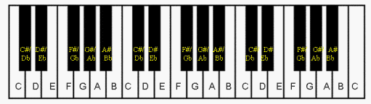
Simple Examples
accumulator
circ-5ths
  based on music idea of circle of fifths
  The next "fifth up" is actually 7 notes up from the current one.
D-------A------E-------B------F#----

Slide 41
Class/Superclass Example
define Super = class
static x = 10
static y = 11
field a
field b
method init = proc( m, n ) {
set a = m;
set b = n;
self
}
end
Super
$x
$y
a
b
init( m, n )

Slide 42
Class/Superclass Example
define Sub = class extends Super
static x = 20
static z = 22
field a
field c
method init = proc( p, q, r ) {
.<super>init(*(p,2),q);
set a = p;
set c = r;
self
}
end
Super
$x
$y
a
b
Sub
init( m, n )
$x
$z
a
c
init( p,q,r )

Slide 43
Class/Superclass Example
--> define obj = .<new Sub>init( 100, 130, 160 )
object
--> <obj>a
100
--> <obj>b
130
--> <obj>c
160
--> <obj>super
object
--> <<obj>super>a
200
--> <<obj>super>b
130
--> <<obj>super>c
no binding for c
Super
$x
$y
a
b
Sub
$x
$z
a
c
init( m, n )
init( p,q,r )

Slide 44
When an Object is Created
Object is allocated.
Object gets an environment whose bindings refer to the methods and fields.
Object also gets connected to the static environment of its class.
A separate object part is created for every class in the ancestor chain!
  Those object parts are also chained together.
Search order: wheres-waldo.obj

Slide 45
reviewing…

Slide 46
When an Object is Created
Class variables
  myclass: refers back to class
  superclass
Instance variables
  this: the object environment in which the current method is running (may not be bottom of object chain)
  super: the environment of the part of the object chain above this
  self: the actual object, i.e. the bottom of the object chain (defined at the top of the chain)

Slide 47
Objects: More Syntactic Sugar?!
See this example.
obj-no-classes.obj

Slide 48
Summary
What are the requirements for a language to be object-oriented?
What are some OO language designs?
(How does OBJ do object orientation?)
  Important: how environment concept is applied
What are the syntax and semantics of OBJ?
For homework, check out other new stuff.
  lists
  characters and strings
  output primitives

